Slide 1
Chapter 8-2 Slope-Intercept Form
Integrated mathematics 9

Slide 2
Slope-Intercept Form
$$y=mx+b$$
m is the slope and b is the y-intercept
y-intercept: where the line crosses y-axis.

Slide 3
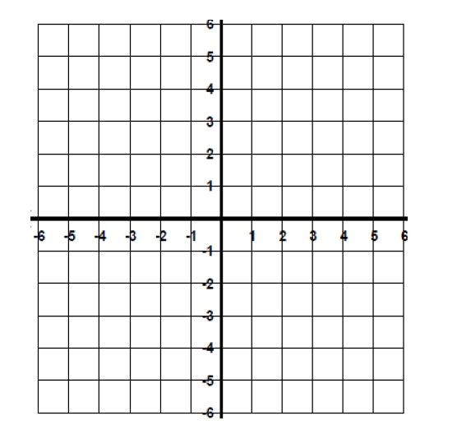
Graph the Equations using y = mx + b
$$y=2x−3$$

Slide 4
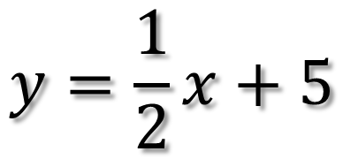
Graph the Equations using y = mx + b
$$y=\frac{1}{2}x+5$$

Slide 5
Graph the Equations using y = mx + b
$$y=−3x−2$$

Slide 6
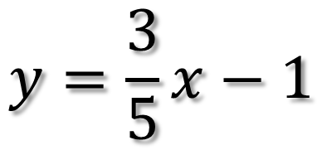
Graph the Equations using y = mx + b
$$y=\frac{3}{5}x−1$$

Slide 7
Graph the Equations using y = mx + b
$$6x−3y=12$$

Slide 8
Graph the Equations using y = mx + b
$$2x+y=6$$

Slide 9
Graph the Equations using y = mx + b
$$−2x−8y=32$$

